Slide 1
Block chain Based Crime Record Management System
ANASWARA K P MCA-A

Slide 2
Contents
Relevance of Topic
Project Description
Objectives of Study
Existing System and Proposed System
Modules identified
Input / Output code Description
UI Design and Implementation Details

Slide 3
Abstraction
Block chain technology is a technology that uses decentralized ledgers to keep transaction records.
Thereby it provides:
Security
Transparency
Less transaction time
No middle-men in transaction

Slide 4
Here a FIR record storage system based on blockchain technology is used to store the data, which helps to attain integrity and security . Our system presents ways in which the authority can maintain the records of cases efficiently
Crime records are highly sensitive public records. By incorporating case records of A police station in A blockchain, authenticity and rigidity of records can be maintained.
It also helps to keep the data safe from adversaries.

Slide 5
Objective of the study
To integrate blockchain with crime record :
To provide a method to secure the FIR system using blockchain technology
To provide better transparency and security to data.

Slide 6
Existing System and Proposed system
In existing system we does not have any computerizes system to trace the crime record history and data tempering tracing technic. Police station are register FIR on computer system and then changed after the political pressure or higher authority police officers pressure. So data cannot contain integrity and people cannot get justice . so we are make this system for police station crime records to store data secure.

Slide 7
The proposed system is a Decentralized system.Here introduce the existing system by implementing the blockchain technology .By using this method the security of the FIR data increased and ensure transparency . No manipulations occure, without the permission of blockchain admins no changes done.

Slide 8
Modules
Data storage
Data encryption
Data retrieval
Transaction validation

Slide 9
Algorithm
SSH Algorithm
SSH – Secure Shell
Used for encryption and transfer data securely over insecure network.
Only admin can decrypt using his secret key and view.

Slide 10
Input / Output code Description
Code to manage approval of each blockchain admins.
Code to encrypt the ledger.
Code to generate blocks.

Slide 11
UI Design and Implementation Details
Django
Django is a free and open-source, python-based web framework that follows the model–template–views architectural pattern.
PyCharm
PyCharm is an integrated development environment used in computer programming, specifically for the Python programming language.
It is developed by the company JetBrains.
HTML/CSS

Slide 12
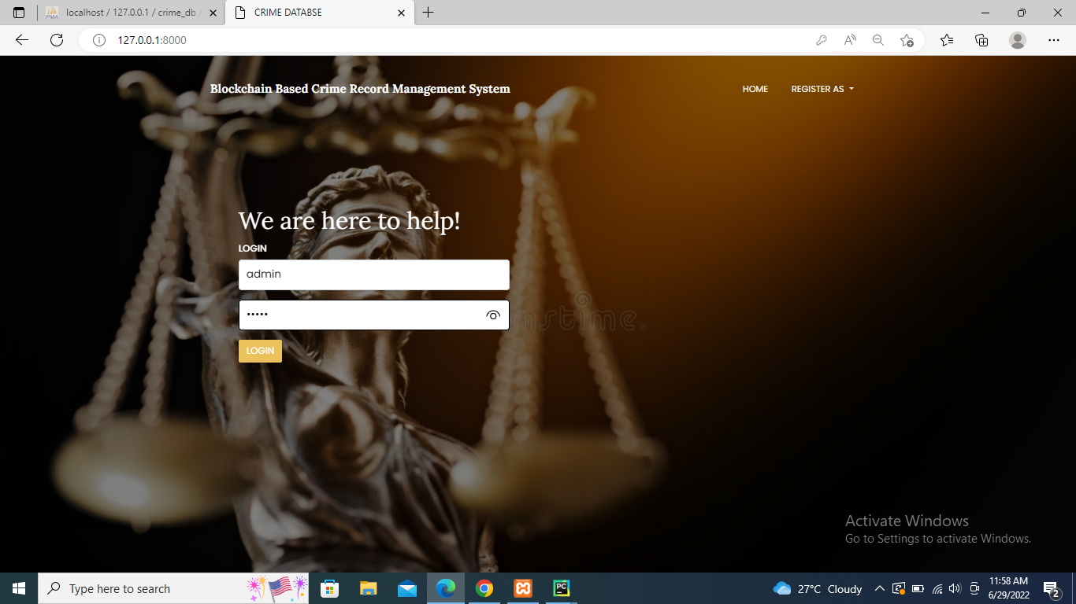
Screenshots
Home Page

Slide 13
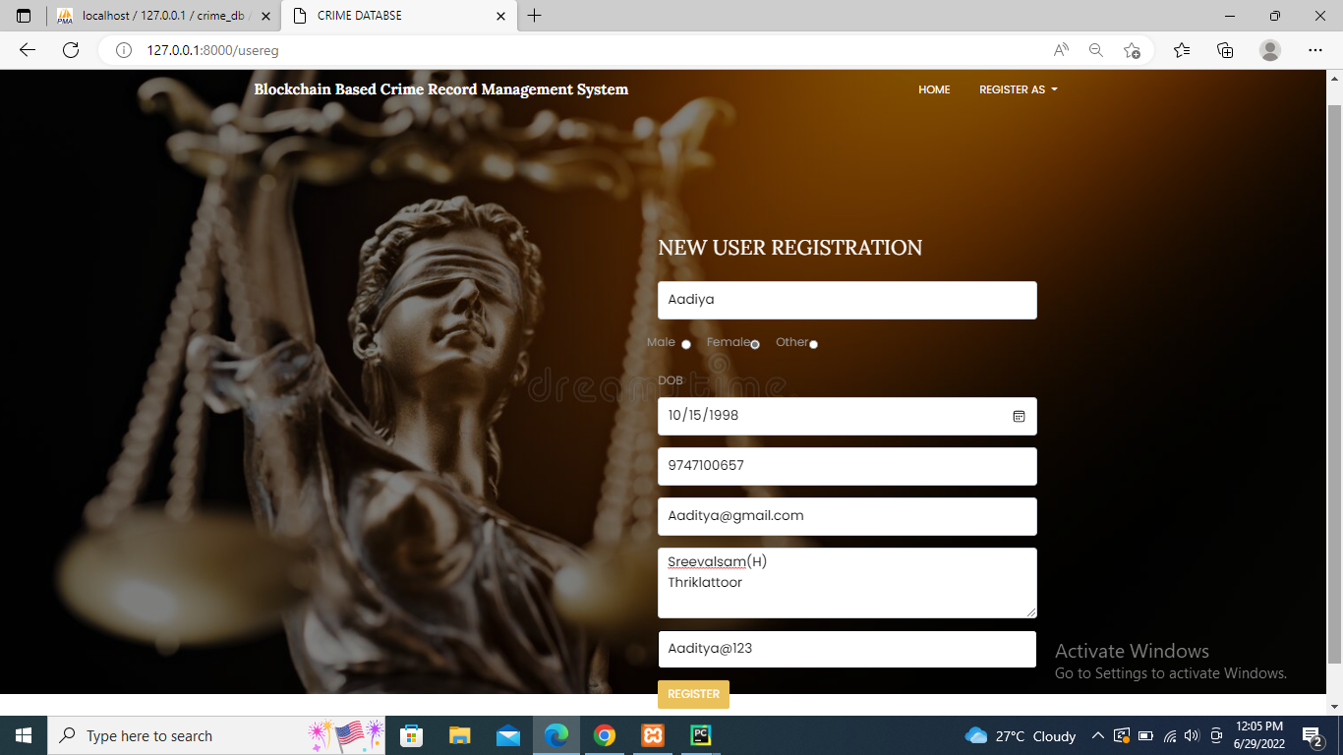
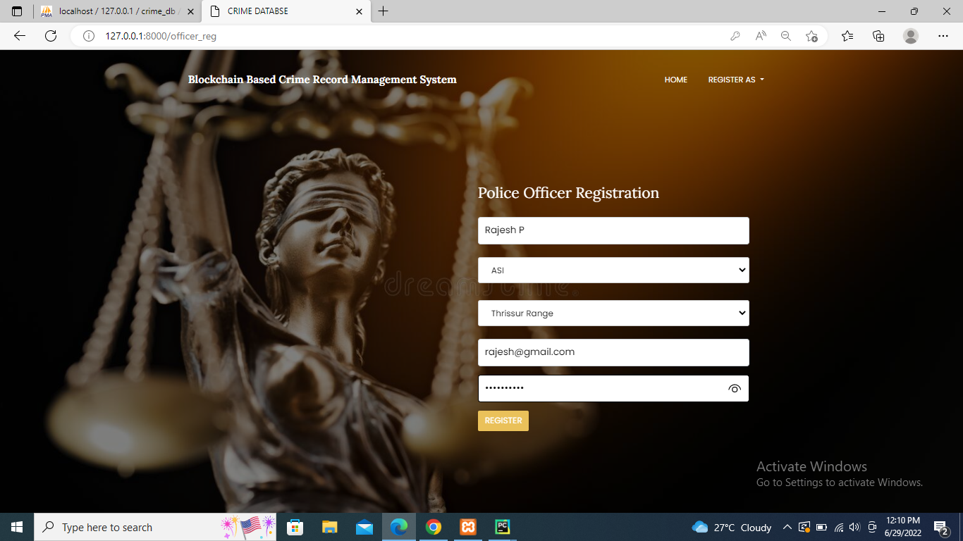

Slide 14
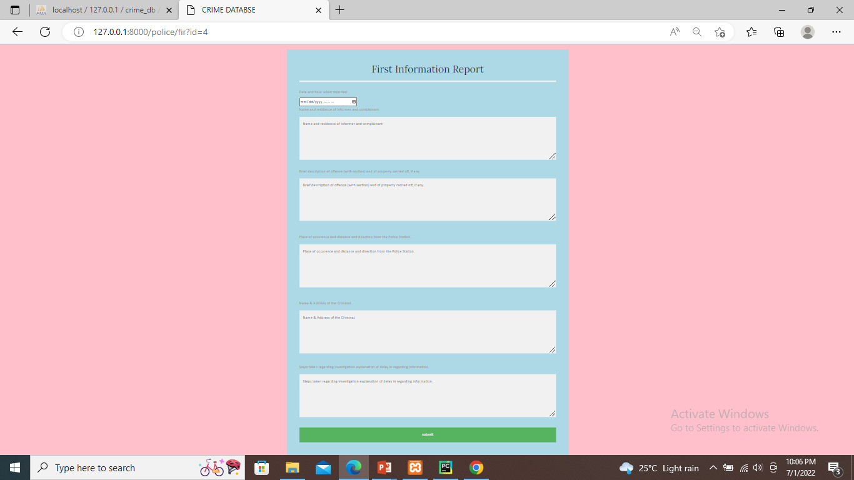

Slide 15
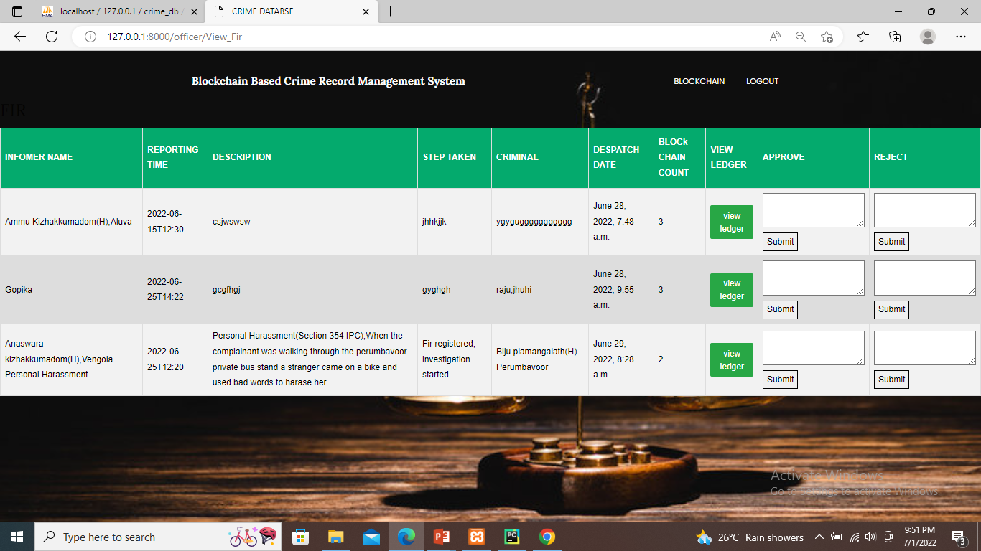
Blockchain Admin

